Slide 1
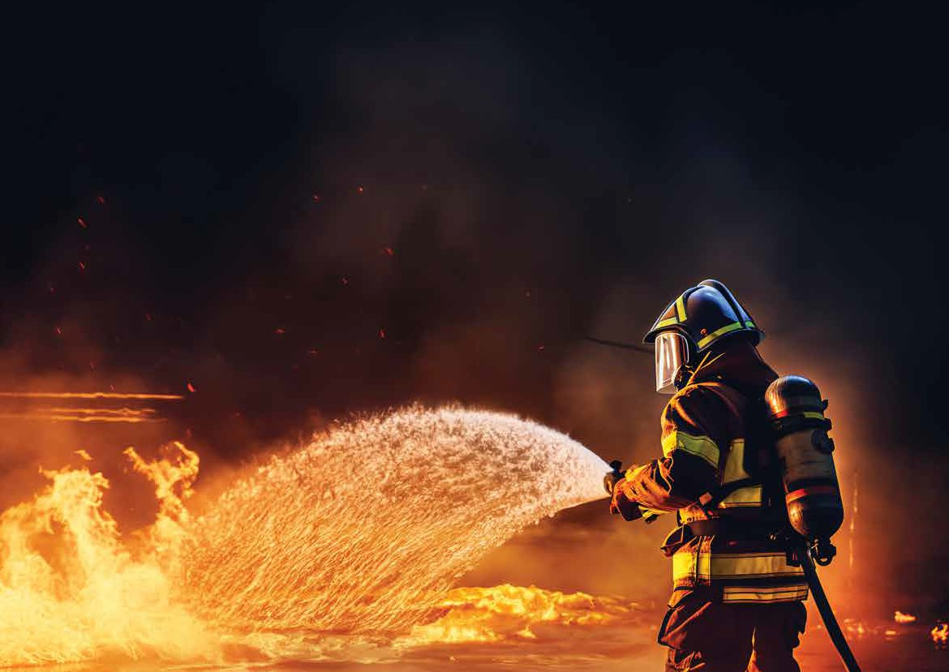
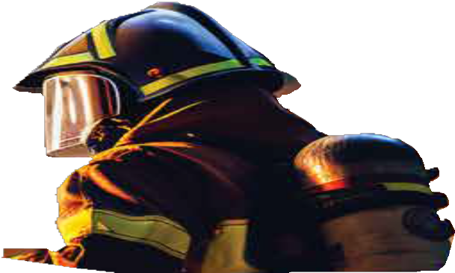
A NATIONAL CHAMPION
Readiness. Resilience. Response.

Slide 2
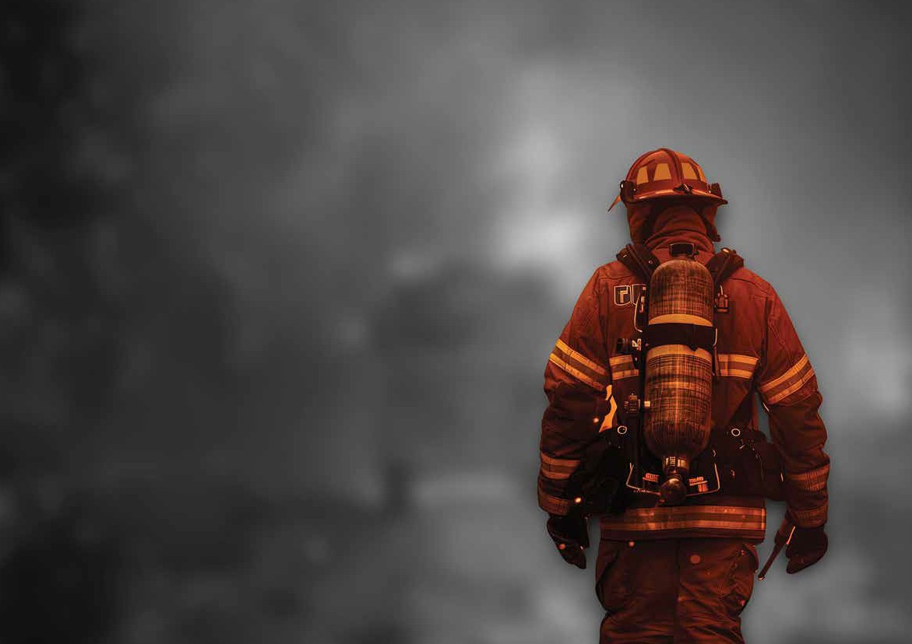
ABOUT US
Empowering Resilience. Elevating Readiness.
Jaheziya is a premier provider of emergency response services, specialized training solutions, and strategic consultancy, headquartered in the United Arab Emirates.
We serve a broad spectrum of sectors including government, defense, aviation, energy, and critical infrastructure - enabling organizations to fortify operational resilience and elevate their emergency preparedness. With an unwavering commitment to excellence, Jaheziya is recognized for its integrity, regulatory compliance, and high-performance capabilities in high-stakes environments.
Our role is pivotal in strengthening national and regional readiness, supporting entities to operate safely and effectively under pressure.

Slide 3
Your Trusted Partner in Preparedness
Jaheziya is the trusted ally for organizations seeking to safeguard their operations and build a culture of preparedness. Our holistic approach - spanning training, consulting, and operational support - positions us as a catalyst for resilience in an increasingly complex risk landscape.
Jaheziya. Prepared for the Unexpected. Committed to Excellence.
Manpower Supply
Critical
Managing and Operating Fire
and Rescue Services
ERS
Supervision
Resilience Assessments
Management of Emergency Fleet
24/7 Emergency Response Teams
Maintenance of Competency
Emergency Services

Slide 4
STATEMENT OF PURPOSE
Jaheziya is committed to advancing world-class standards in emergency preparedness, response, and resilience across the UAE and the region. Through specialized training, expert consultancy, and operational support, we help organizations strengthen readiness, ensure compliance, and protect communities. As a trusted partner in high-risk environments, Jaheziya enables resilience where it matters most.

Slide 5
Accredited Training Excellence
Our internationally accredited training programs are designed to meet and exceed global standards including NFPA, ISO, NCEMA, and OPITO. Delivered by industry veterans with extensive field experience, our courses equip personnel with both the certifications and the competence required to navigate real-world emergencies.
Key areas of expertise include:
Fire and Rescue Operations
Health, Safety, and Environment (HSE) Training
Crisis and Disaster Management
Offshore Emergency Response
Incident Command Systems
Training is available both onshore and offshore, ensuring a flexible, immersive, and outcome-driven learning experience.

Slide 6
Strategic Consultancy Services
Beyond training, Jaheziya provides tailored consultancy services that help organizations proactively assess risks, enhance operational readiness, and achieve full compliance with local and international regulatory frameworks. Our consultancy portfolio includes:
Emergency and Crisis Planning
Business Continuity Management
Risk Assessments and Vulnerability Studies
Development of SOPs and SOGs
Our strategic guidance is grounded in deep regional insight and global best practices, enabling clients to develop robust systems that protect people, assets, and operations.

Slide 7
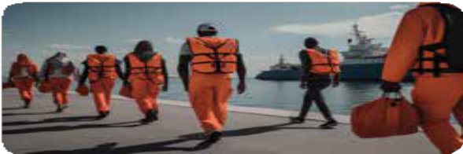
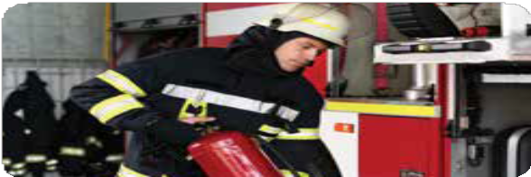
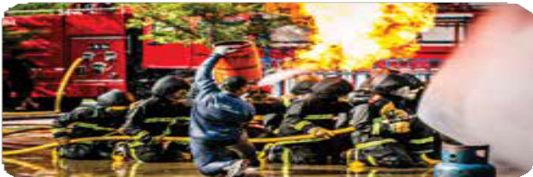
OUR CAPABILITIES
Emergency Services Operations
Fire Fighting & First Aid Training
HSE Training
Maritime & Offshore Training
Offsite and Mobile Training
Inspections, Assesments, Testing & Exercising
Business Continuity & Crisis Management Training
Staff Augmentation and Outsourcing
Advisory & Consultancy Services

Slide 8
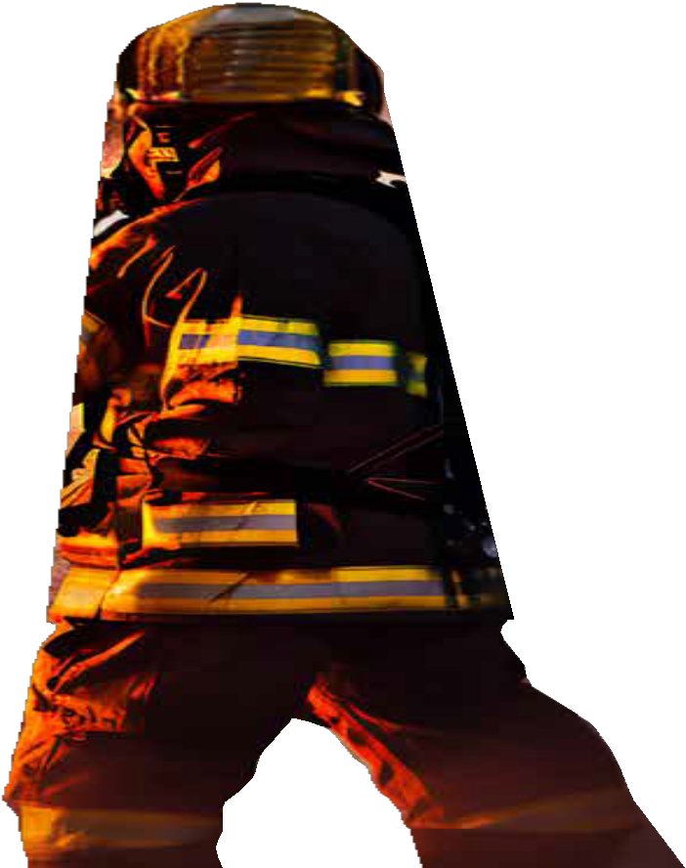
JAHEZIYA IN NUMBERS
Accredited courses
65+
Employees
200+
Founded
2009
75,000M²
Training facility
03
Mobile training units – Aviation, Hazmat & basic firefighitng

Slide 9
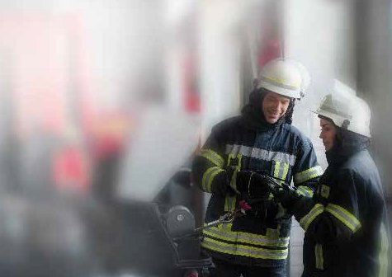
ACCREDITED AND CERTIFIED
General Directorate of Civil Defence Abu Dhabi (ADCD)
UAE Federal Maritime Authority
PRO BOARD ACTVET
Highfield Awarding Body for Compliance (HABC)
TUV NORD OPITO JOIFF IOSH

Slide 10
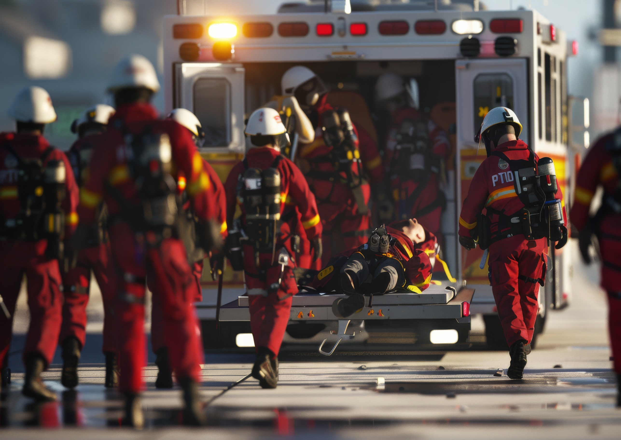
SECTORS
AVIATION
GOVERNMENT
INDUSTRIAL
MARITIME

Slide 11
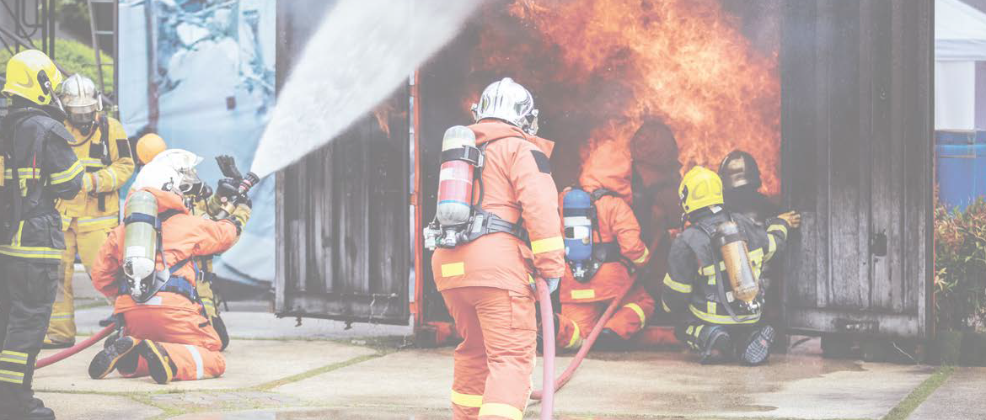
EMERGENCY AND RESILIENCE SERVICES
Turnkey solutions to specialized Fire and rescue and resilience services
Specialized ERS Training
Manpower Supply
Critical Infrastructure
Resilience Assessments
Managing and Operating Fire
and Rescue Services
ERS
Supervision
Resilience Assessments
Management of Emergency Fleet
24/7 Emergency Response Teams
Maintenance of Competency
Emergency Services

Slide 12
CONTACT US
JAHEZIYA, Mussafah South, ICAD III
Abu Dhabi,, United Arab Emirates
P.O. Box 32330
inquiry@jaheziya.ae
+971 2 695 3171

Slide 13
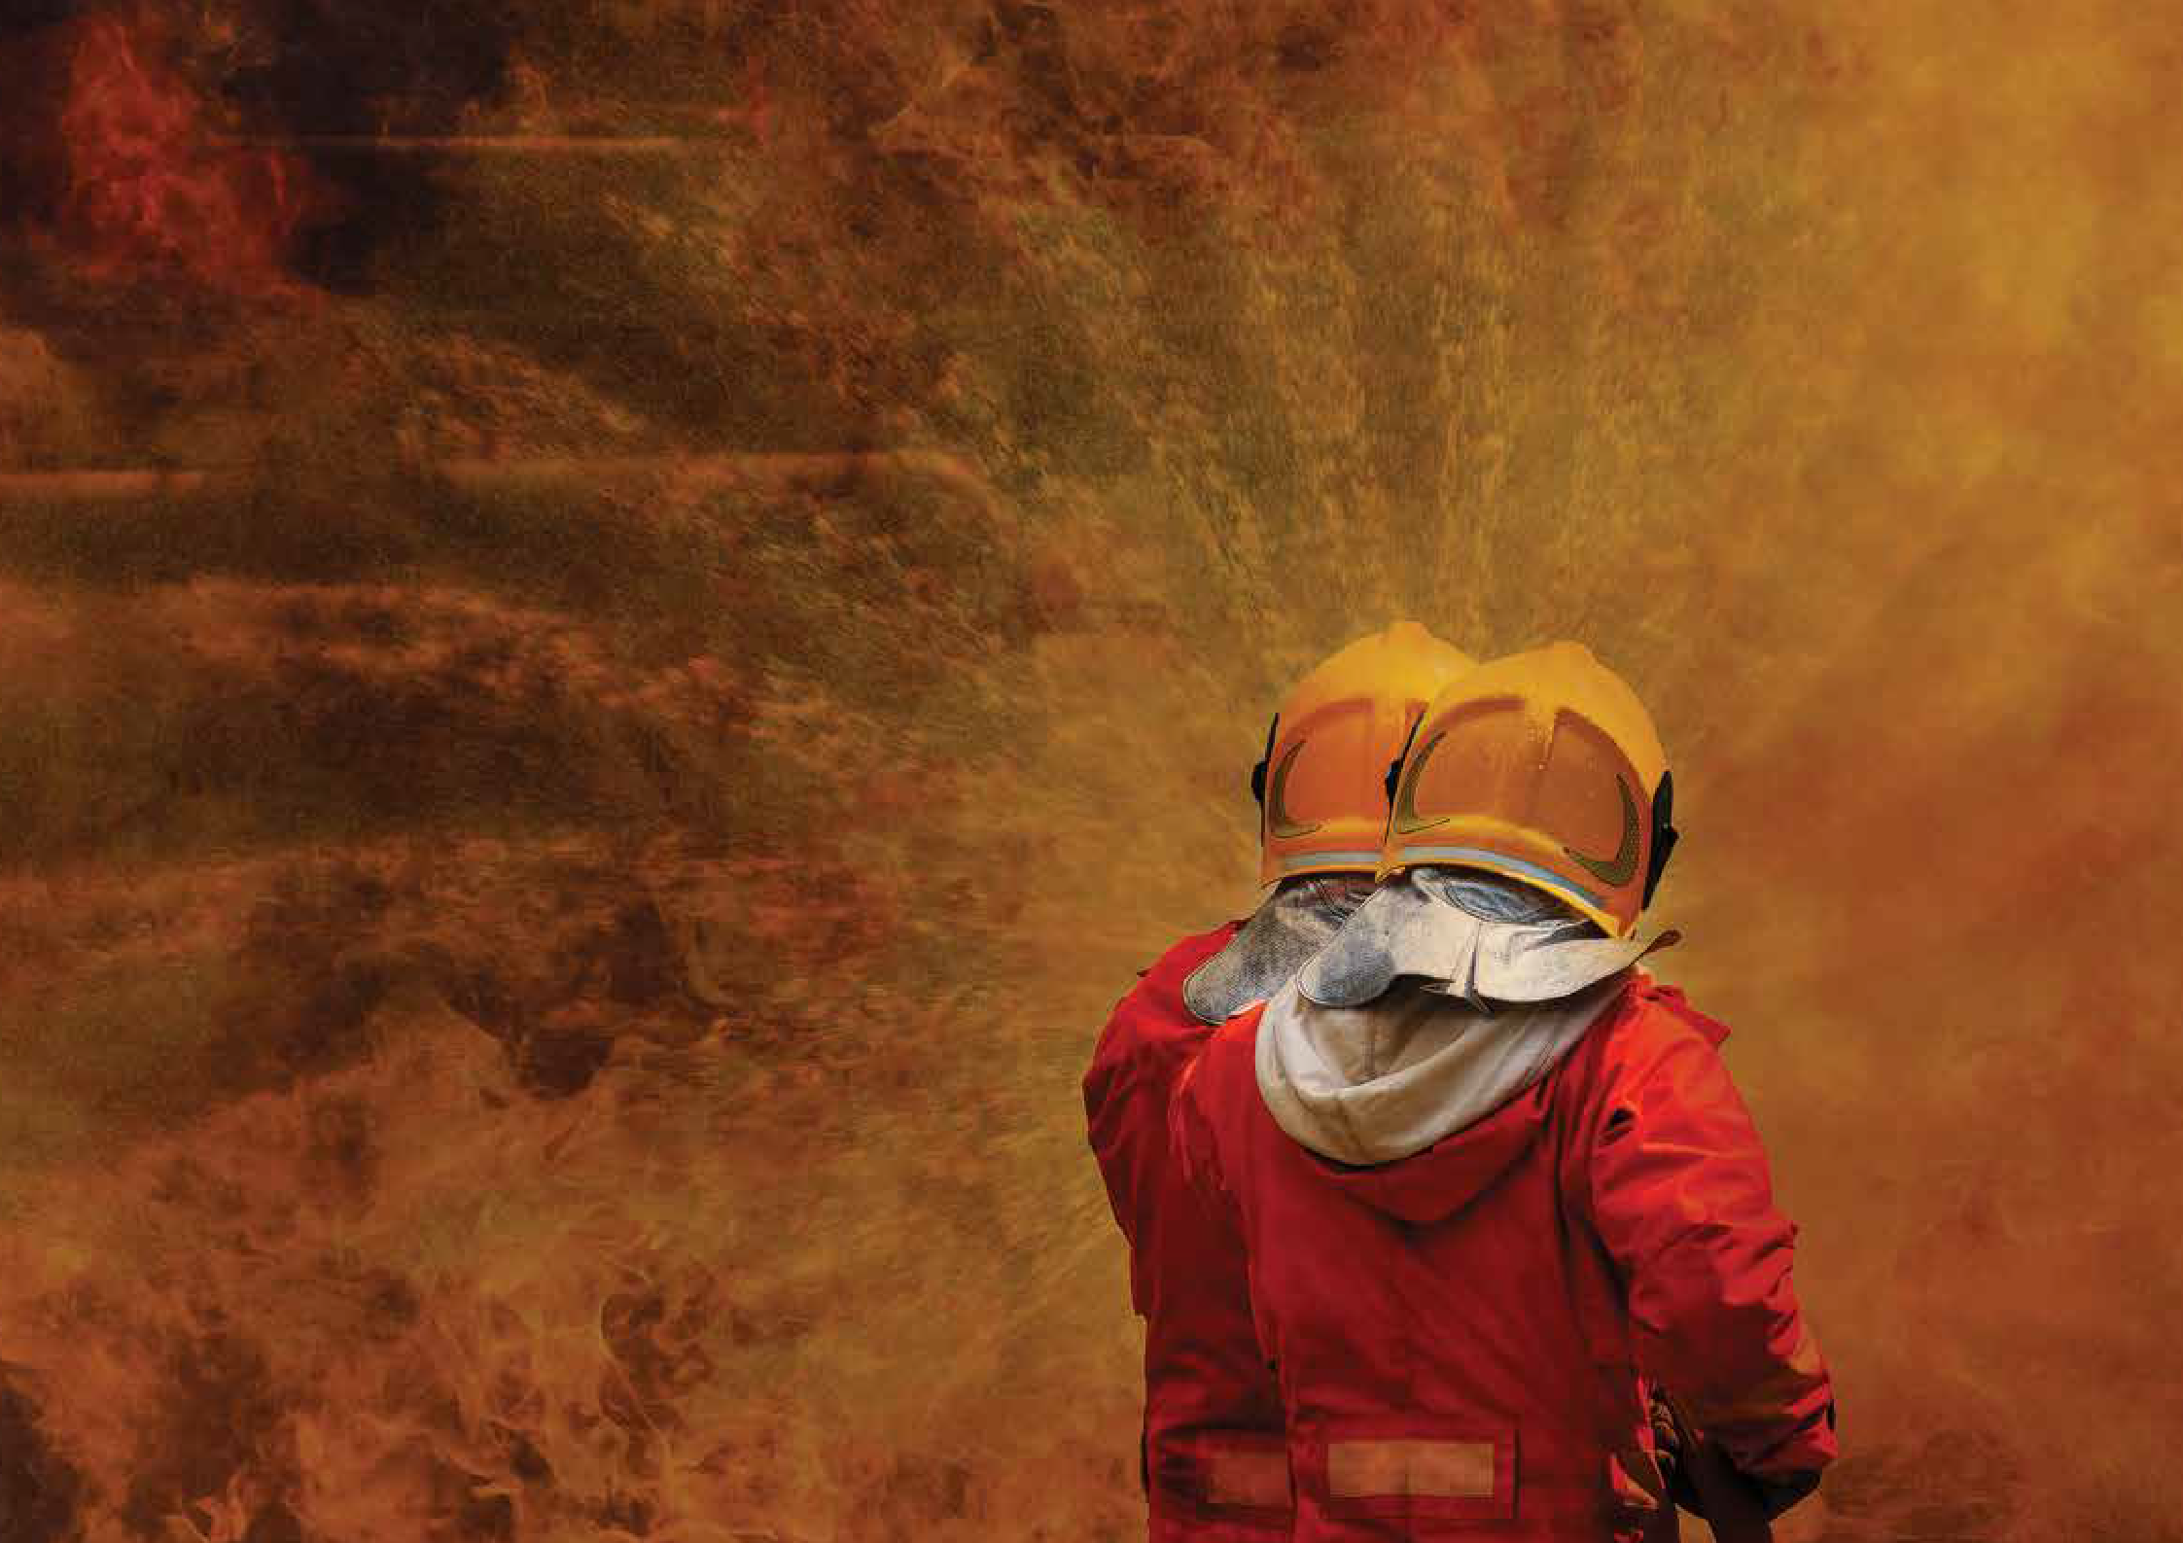
THANK YOU
Readiness. Resilience. Response.

